Slide 1
The Internet
The omnipresent part of our lives - www
Notes:
[1]

Slide 2
The guts of www
Browser
TCPIP and DNS
HTTP
HTML
CSS
Cookies
JavaScript
Notes:
[5]

Slide 3
DNS
DNS flow
NS record
A record
CNAME record
MX records
… goes on
Notes:
[1]

Slide 4
HTTP
Methods (GET, POST, PUT, TRACE, ...)
Status Codes
Keep-Alive
Statelessness
Sessions, Cookies
Caching
Notes:
[2]

Slide 5
Browsers
Differences
Optimizing specifically for browsers
Browser tools
Network
Console
Script
HTML
Storage
APIs (for extensions/plugins/addons)
Notes:
[2]

Slide 6
HTML
Semantics
Connectivity
Forms
Storage
Performance
Graphics
Styling
Notes:
[1]

Slide 7
CSS
Box Model
Selectors
Specificity
Common properties
Transitions
Animation
Notes:
[1]

Slide 8
JavaScript
Basics
Types
Events
The good, the bad and the ugly
Lambdas
Objects
Inheritance
Notes:
[1]

Slide 9
phew...
मर जाऊँगा सब बताते बताते...
Notes:
[1]

Slide 10
What’s in this Session ?
HTTP
Browsers
HTML
CSS
Cookies
JavaScript (next session[s])
Notes:
[2]

Slide 11
… before that ...
a little history
Notes:
[0]

Slide 12

History
CERN, circa 1989
Tim Berners-Lee
First Browser/Editor (“WorldWideWeb”)
First httpServer - “httpd”
Apr 93, released to all
Notes:
[2]
scientists wanted to collaborate, share their findings, data,
Rockstar - Tim had something in mind..
Robert Langdon, Angels and Demons referred to CERN,
http://www.evolutionoftheweb.com/
http://webfoundation.org/about/vision/history-of-the-web/
http://www.w3.org/History.html

Slide 13
.. growing since then
Dec 1995, 16m (0.4%)
Dec 1999, 248m (4.1%)
Dec 2005, 1.01b (15.7%)
Sep 2010, 1.97b (28.8%)
Mar 2014, 2.9b (40.7%) *
Ref: http://www.internetworldstats.com/emarketing.htm
Notes:
[1]
* estimates

Slide 14
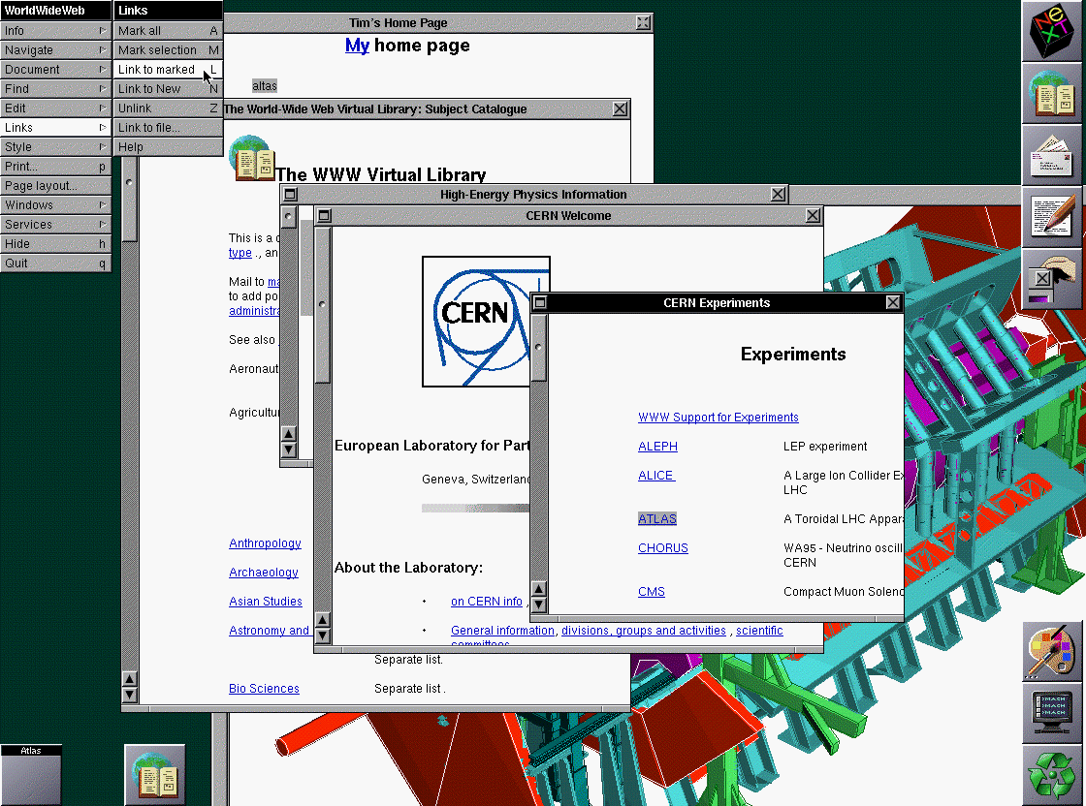
Browsers (WorldWideWeb)
Notes:
[1]
The first browser built in 1990, WorldWideWeb. Built on NeXT
Anybody read Steve Jobs ?

Slide 15
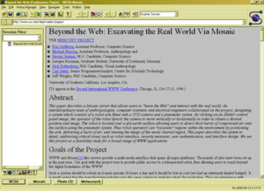
Browsers (Mosaic - ‘93)
Notes:
[1]
Developed by part-time employee Marc Andreessen for NCSA, called NCSA Mosaic or just Mosaic. First browser to display Images inline

Slide 16
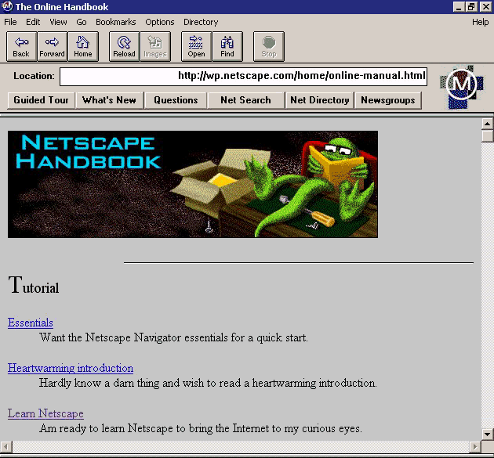
Browsers (NN - ‘94)
Notes:
[1]
Marc formed a company Mosaic Comm. Company, which became Netscape and released Netscape Navigator

Slide 17
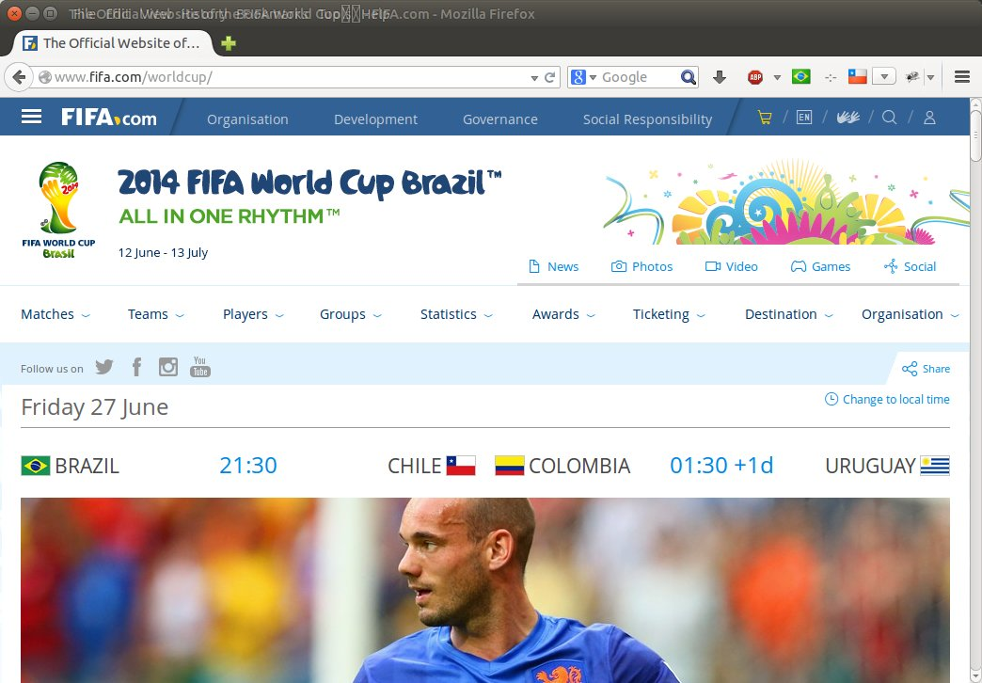
Browsers - Firefox ‘14
Notes:
[1]

Slide 18
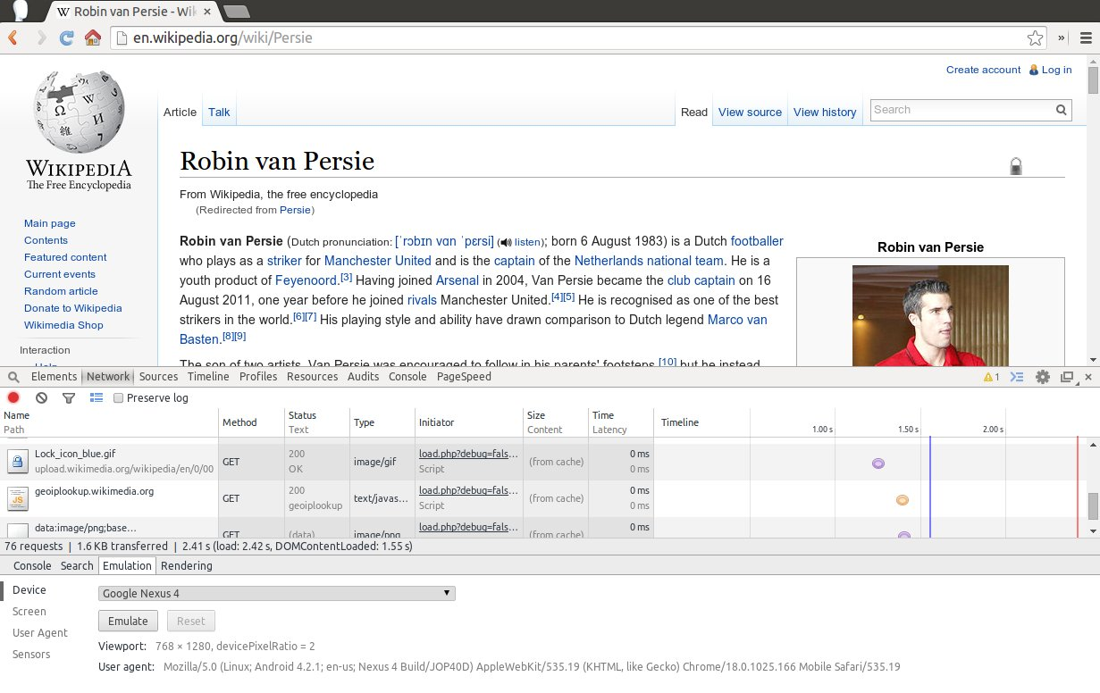
Browser - Chrome ‘14
Notes:
[0]

Slide 19
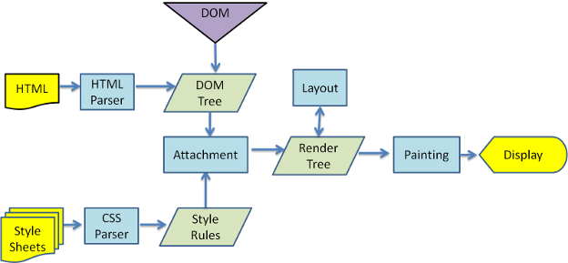
Browser - flow
Notes:
- render tree - creates rectangles with all possible attributes, color, size, and also the order to be rendered
- layout process - is setting up the offsets, exact co-ordinates
- painting - is the process when the TREE is actually displayed on the screen.
http://taligarsiel.com/Projects/howbrowserswork1.htm

Slide 20
HTTP
A protocol for browser to “talk” with a WebServer
Contains a Header and Body
Methods like GET, POST
Lets see a simple demo
Telnet
Browser
Notes:
[10]
With this, I’ve already introduced you to a Great debugging tool in browser, the Network Monitor !!!
telnet localhost 80
GET /ruturaj/request.php?a=b&p=q HTTP/1.1
Host: localhost
http://localhost/ruturaj/request.php
http://ruturajv.wordpress.com/category/http/

Slide 21
enough of that HTTP
one down, more to go!

Slide 22
HTML
a Hyper-Text-Markup-Language
Might’ve heard many versions, 4.x, html5
Describes structure and semantics of the page
It also directs how to render the page - fiddle1
Some tags to play along
Lists, <ul>, <ol>
<p>, <table>
<form>, <input>, <textarea>
Notes:
[2]
Play with fiddle by adding a blockquote, “No it is not”
Done: HTML all by itself is just this much….
NED - ESP Slide ahead..
http://w3schools.com
http://www.w3.org/2002/03/tutorials

Slide 23

topics flying like RVP in NED 5 - 1 ESP

Slide 24
CSS
Cascading Style Sheets
For styling pages (Zen)
Notes:
[5]
http://www.w3.org/TR/CSS21/

Slide 25
CSS
Basics + Selectors (class, id, tag) - Flukeout
The Box Model
Block level elements, <div>, <p>, etc
Inline elements, <a>, <span>
Specificity (inline, id, class, element)
Notes:
[10]
Basics - Could give basic ideas of selectors on whiteboard and then do simple demo on http://flukeout.github.io/
Box model, explain the properties involved..
http://www.w3.org/TR/CSS2/box.html
https://developer.mozilla.org/en-US/docs/Web/CSS/box_model

Slide 26
CSS - Common properties
Visual - display, float, z-index
Box - width, height, border, margin, padding
Text - text-align, text-decoration, letter-spacing, word-spacing
Colors / Backgrounds - color, background-color, background-image, background-attachment, background-repeat
Fonts - font-family, font-weight, font-style
Notes:
[15]
Before next slide delete all ‘localhost’ cookies.

Slide 27
Cookies
Client side pieces of name-value pair
Attributes
expiry (ttl)
path
domain
security
HTTPOnly
Notes:
[5]
Originally stored as simple text file but now ...
In firefox cookies are now stored as sqlite3 database
cd /home/rutu/.mozilla/firefox/h5kt2gvh.default
sqlite3 cookies.sqlite
sqlite> .headers ON
sqlite> select * from moz_cookies limit 5;

Slide 28
Cookies - Attributes.
TTL
Path
Domain
Secure
HTTPOnly (can’t be accessed at Client)
Notes:
[15]
show how to see cookies in the browser’s [Resources] tab.
Show Set-Cookie Response header and the Cookie Request header
http://localhost/ruturaj/cookies/simple-cookie.php ( this sets a session cookie, with no other params - Show them the header in the network) and thus also explain the network tab.
http://localhost/ruturaj/cookies/ttl-cookie.php (show what has changed)
Before going to path cookie - show what is the path value … then open
http://localhost/ruturaj/cookies/path-cookie.php
Now access just http://localhost/ and show the headers

Slide 29
Cookies - Access
Server Side
PHP - $_COOKIE
Java Servlets - request.getCookies(); // Cookie[]
…
Client Side JavaScript document.cookie
Notes:
[10]
http://localhost/ruturaj/cookies/get-cookies.php
document.cookie.split(/\s*;\s*/)

Slide 30

I need a break !!
Notes:
.. so lets build a simple APP, no storage, no-nonsense, just pure HTML, javascript and CSS

Slide 31
TODO App
no storage, just UI and interaction
Notes:
[1]
- Total 1:45
http://localhost/ruturaj/todo.html (just show and ask them to build it)
https://gist.github.com/ruturajv/c6bc710f045f0e13b67f (this is with full-code)

Slide 32
Basic Structure...
TODO - JSFiddle 1
But before that...
Notes:
[1]
Please fork out of this jsfiddle and start adding a todo.
http://jsfiddle.net/ruturajv/wjLT3/ (base code to build on)
But before that ...

Slide 33
JavaScript
a little insight...

Slide 34
JavaScript - Evolution
NN β2 needed client script ~1995
Brendan Eich hired for Scheme implementation
Instead creates new language - LiveScript
Later renamed as JavaScript
Microsoft creates JScript (~1996) for IE 3
Netscape submits to ECMA ~97
Notes:
[5]
… and we thought there were just browser wars
ECMA - European Computer Manufacturer’s Association
now all JavaScripts are some implemented standards of ECMAScript
JavaScript all by itself can’t do anything, it needs a host environment, commonly browser, but recently into serverside env. like node.js, CouchDB, even GUIs like GNOME
Ref:
https://www.w3.org/community/webed/wiki/A_Short_History_of_JavaScript
http://archive.oreilly.com/pub/a/javascript/2001/04/06/js_history.html

Slide 35
Types - Number
no Integer
64 bit floating point (aka Double)
try doing (0.1 + 0.2) == 0.3
Notes:
[2]
remember its a float
I’ve now introduced to a wonderful tool - the console ! (can give more idea about it)

Slide 36
Types - NaN
A special type: Not a Number
Results from erroneous arithmetic oper.
And its strange
typeof (NaN) = “number”
NaN != NaN
Notes:
[2]

Slide 37
Number function
Number(identifier) converts value to number
Generates NaN on error
+ prefix operator does the same
Notes:
[3]
Beware with parseInt, it stops at first non number character
Eg.
Number(“a”)
+”1”

Slide 38
parseInt
parseInt(value, radix*) Defaults to 10
Stops at first non digit character
Similar function parseFloat is available
Notes:
[3]
wonder how are these functions available ? which scope ? Its the window object, you could use window.parseInt()
Try
parseInt("10", 2) // Binary
parseInt("11", 2) // Binary
parseInt("f", 16) // Hexadecimal
parseInt("ff", 16) // Hexadecimal
JavaScript has got a global object defined, in browsers its the window object, or this or self.
In node.js - this global object is accessed by variable “global”
try on node.js - global == this

Slide 39
Math
Java fans will like this Math-namespaced methods
abs
floor
log
max
pow
sqrt
Notes:
[1]
try typing “Math” in your console
here is the object navigator found in the browser development tools.

Slide 40
String
UCS-2 16bit sequences (not UTF-16 though)
No separate ‘char’ type
Just like JAVA, Strings are immutable
BUT string1 == string2
Literals can use ‘ or “ characters
String.length gives no. of 16bit chars.
can use String(identifier) to convert
Notes:
[3]
Check length of “I <3 \u20b9”
var s_prim = 'foo'; var s_obj = new String(s_prim); console.log(typeof s_prim); // Logs "string" console.log(typeof s_obj); // Logs "object"

Slide 41
String methods
indexOf
replace
toLowerCase
toUpperCase
concat
...etc
Notes:
[1]

Slide 42
other types...
Boolean(identifier) returns if truthy / falsy
null is a value that isn’t anything
undefined
is an uninitialized value
is default values for variables and params
value of missing members
Notes:
[3]
We’ll come to truthy falsy later…
try typeof (someRandomIdentifier)

Slide 43
Falsy ? some new Lingo ?
false
null
undefined
“” empty string
0
NaN
Notes:
[3]
no..!

Slide 44
Truthy
true
{} / Empty object literal
“some string”
Math.PI (some non 0 number)
Notes:
[2]

Slide 45
everything else is …
“I OBJECT milord”
Notes:
[1] ~ 0.5 hours

Slide 46
Objects
Collection of name value pairs
Unification of Object and Hashtable
Name can be any string and value any type except undefined
Can be accessed with dot or subscript notation
new Object() or {}
A member can be assigned any type, object, func, array
Notes:
[5]

Slide 47
Objects - literal
var employee = {
name: "John Doe",
sex: "twice a week",
age: 25
};
Notes:
[1]

Slide 48
Objects within objects
var employee = { name: "John Doe", sex: "twice a week", age: 25, address: { city: "Mumbai", pin: "400001" }
}
Notes:
[2]
can access employee.name or employee[‘name’]
employee[‘name’].address

Slide 49
Objects …
delete deletes members
delete employee.age
employee.age // returns undefined
Notes:
[2]

Slide 50
By reference...
Objects can be passed as arguments drawRectangle({w: 200, h: 100, color: ‘white’})
Objects are passed by reference
== compares object references
({name: “A”, age: 20}) == ({name: “A”, age: 20}) // FALSE just like java ;)
Notes:
[1]

Slide 51
Arrays
new Array() or [“a”, 1, 4, 3.14]
typeof([“abcd”, “pqr”]) // returns object
Indexes are converted to strings, hence unbounded
Efficient for sparse data - otherwise not
has got a special .length member
NEVER use in for..in iteration
Notes:
[5]

Slide 52
Arrays (deleting)
Deleting Elements
myArray = ['a','b', 'c', 'd'];
delete myArray[1];
// ['a',undefined, 'c', 'd']
myArray.splice(1, 1);
// ['a', 'c', 'd']
Notes:
[2]

Slide 53
Arrays (identifying)
typeof ( [] ) // “object”
array1 instanceof Array // TRUE
array1.constructor == Array
Notes:
[2]

Slide 54
Scope

Slide 55
Scope
There is no block scope if (true) { var name = “ABC”; } console.log(name); // dumps ABC
Only functions have scope function myFunction() { var x = 10; // local to myFunction } x; // undefined
Notes:
[1]
let - from ECMA 6 (2015) onwards does support block scope

Slide 56
Scope
function myFunction() {
var x = 10; // local to myFunction
function innerFunction() {
var y = 20;
x // returns 10
}
innerFunction();
y; // undefined
}
x; // undefined
Notes:
[2]

Slide 57
To === or not to ==
भला तेरा “=” मेरे “=” से ज्यादा कैसे ?

Slide 58
To === or not to ==
== does type coercion 0 == “0” // TRUE
Avoid using ==
=== is type safe 0 === “0” // FALSE
Sameness - MDN can read more here.
Notes:
[4]
https://developer.mozilla.org/en-US/docs/Web/JavaScript/Guide/Sameness

Slide 59
Operators
Arithmetic + - * / %
Comparison == != < > <= >=
Logical && || !
Ternary ?:
Bitwise & | >> >>> <<
Notes:
[2]

Slide 60
Operators - && - Guard operator
Logical AND
If first operand is truthy
then result second operand
else result is first operand
Can be used to avoid null ref. if (a) { return a.member; } else { return a; }
Can be written as return a && a.member
Notes:
[3]

Slide 61
Operators - || - Default Operator
Logical OR
If first operand is truthy
then result first operand
else result is second operand
Can be used to fill defaults var last = input || nr_items;
Notes:
[3]

Slide 62
Statement - for
Iterate through array for (var i=0; i<array.length; i++) { // refer to value as array[i] }
Notes:
[2]

Slide 63
Statement - for (as each)
Iterate through members of array
for (i in object) { console.log(i, object[i]); }
function O1(){} O1.prototype.name = "abcd"; o2 = Object.create(O1.prototype); o2.age = 23; console.log(o2); for(i in o2) { if (o2.hasOwnProperty(i)) console.log(i, o2[i]); }
Notes:
[5]
Hence, Never use for each style for array

Slide 64
Statement - switch
Switch value can be an expression, not just a string or a number
switch (new Date().getDay()) { case 0:
day = “Sunday”; break; case 1:
day = “Monday”;
break;
}
Notes:
[2]

Slide 65
Careful - linefeeds
JavaScript tries to add “;” where it finds error var name = “foo” var bar = name console.log(bar)
function gA(){
return
{
name: 'a'
}
}
typeof (gA());
Works in other Lang.
function gA(){
return {
name: 'a'
}
}
typeof (gA());
Works well in JavaScript
Notes:
[5]

Slide 66
Coding Standards
strict mode
prevents declaring variable without var
duplicate param name declaration results err.
… and more
Use JSLint
http://javascript.crockford.com/code.html
Notes:
[2]
function f(){
"use strict";
blah ="fo";
}
f();
- prevents declaring variables without var
-
~ 55 mins

Slide 67
What about the TODO app ?

Slide 68
TODO App … but …
DOM
Event handling
XMLHttpRequest
Notes:
[2]

Slide 69
DOM
Document Object Model
Structured representation of HTML / XML Tree
Programmatic interface to the content
document object
Notes:
[10]
take a look at any web page.
Here we introduce the DOM browser of the Browser tool

Slide 70
DOM - Linkages
<html>
<body>
<h1>Heading</h1>
<p>some text 1</p>
<p>some text 1</p>
</body>
</html>
Notes:
[10]
Show on a board references to firstChild, childNodes, lastChild, parent, nextSibling, previousSibling

Slide 71
DOM - Basic APIs - retrieve
Older
getElementById()
getElementsByTagName()
Young Gen
querySelector()
querySelectorAll()
Notes:
[10]
give a demo on any web page

Slide 72
DOM - manipulation
creating Elements
document.createElement()
node.cloneNode([false|true])
adding Elements
node.appendChild(newElem)
parentNode.insertBefore(newElem, refElem)
deleting Elements
parentNode.removeChild(elemToBeRemoved)
Notes:
[15]
Show live examples
best use google.com and work on that .. adding buttons, input boxes, etc

Slide 73
DOM - Styling
Wasn’t CSS supposed to do the job ?
API to change styling as well.
node.style
node.className
window.getComputedStyle(elem)
.style.cssAttributeName = value
Notes:
[10]
change color of google.com’s search box background

Slide 74
Events
Browser is single threaded, event based
Events help program interactions like
click, dblclick
mouseover, mousedown, mouseup, mouseout
blur, change, focus, keydown, keyup, keypress, submit, reset
load, readystatechange, resize, scroll
Tons of events - https://developer.mozilla.org/en-US/docs/Web/Events
Notes:
[5]

Slide 75
Event flow
capturing
bubbling
http://localhost/ruturaj/event-capturing-bubbling.html
https://gist.github.com/ruturajv/a13772da1bdb7eab8d22
Notes:
[15]
explain

Slide 76
Events - attaching
element.onevent = function(){}
element.addEventListener(“event”, function(eventObject){}); // Chrome, Firefox
element.attachEvent(“onevent”, function(){}) // IE
<tag onevent=”fnCall()” >
function addEvent(elem, type, listener) { if (e.addEventListener) elem.addEventListener(type, listener, false) else elem.attachEvent(“on”+type, listener) }
Notes:
[10]
element.onevent = u can attach only 1 event

Slide 77
Events - event Object
Chrome/Firefox pass event object to listener
IE has a global window.event
In code we do … obj.addEventListener(“click”, function(e) { var e = e || window.event; var targetElement = e.target; // do stuff element }, false);
Event.target - Gives ref. to the object where event was triggered
Notes:
[15]
modify the capture events script to show… attach event to the body and show

Slide 78
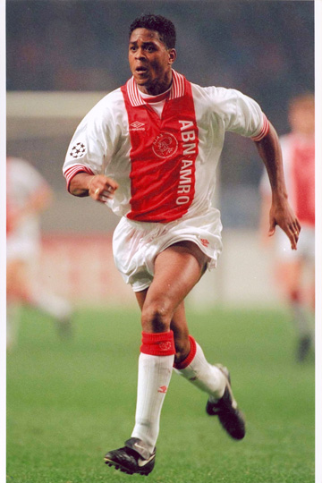
AJAX - XMLHttpRequest
Founded in 1900, long before HTTP :D
AsynchronousJavascriptAndXML Term coined by Jesse James Garrett ~2005
Basically Async HTTP request
Event handler can be bound to it
UI can be changed / refreshed upon the response
Eg. http://localhost/ruturaj/todo-ajax.html
Notes:
[10]

Slide 79
concludes basic JavaScript, DOM, Events, Ajax
Notes:
[0]
~2 hrs

Slide 80
TODO - Yet Again …
This time really start work on it.
Notes:
[~1 hr.]
start getting inputs from guys to create the app!

Slide 81
Thanks ...

Slide 82
JavaScript - until now …
The Browser environment
Small but smart, the object played and passed around
Intelligent function still to play its cards
Notes:
[2]
browser env. - how IE and W3C are diff. and at times you need to work along both simultaneously
JavaScript - Powerful
Object - till now we’ve just seen it as a dictionary like object

Slide 83
Functions
are first-class objects
Can be passed, returned
Inherit from Object and can save name/val
Notes:
[1]

Slide 84
Functions as
statements
expressions
methods
constructors
Inner functions
Closures
Notes:
[1]

Slide 85
function operator
function fnName (parameters) {
// statements
}
// Call
fnName(params);
A function can appear anywhere that an expression can appear
Notes:
[1]
Its the simplest form of the function that we know of. plain and easy

Slide 86
function statement
just a shorthand to var statement
function foo() {} expands to… var foo = function() {};
Simply call as foo()
Notes:
[1]

Slide 87
inner functions
They don’t have to be top level
Can be defined within other functions
An inner function can access variables defined in its parent function
Notes:
[1]
function A(){
var name ="abcd";
function B(){ return name; }
return B();
};
A();

Slide 88
Closures
The scope that an inner function enjoys continues even after the parent functions have returned
Thats called closure
Notes:
[1]

Slide 89
Closures
function makeAdder(x) { return function(y) { return x + y; }; } var add5 = makeAdder(5); var add10 = makeAdder(10); console.log(add5(2)); // 7 console.log(add10(2)); // 12
Notes:
[5] function makeAdder(x) {
return function(y) {
return x + y;
};
}
var add5 = makeAdder(5);
var add10 = makeAdder(10);
console.log(add5(2)); // 7
console.log(add10(2)); // 12

Slide 90
function as objects
they are objects, so can save name/value pairs
Its similar to static members function Car(name) { return name; }; Car.noOfWheels = 4; Car(“honda”) // honda Car.noOfWheels // 4
Notes:
[1]
assignment of members to functions is little more than simple, as we shall see later.

Slide 91
function as method
Since function are values can be saved in objects
A function in object is called method var site = {}; site.test = function (string) {
console.log("Hello World! " + string);
site.string = string; } site.test("Boo!");
Notes:
[1]
var site = {};
site.test = function (string) {
console.log("Hello World! " + string);
site.string = string;
}
site.test("Boo!");

Slide 92
function call / invocation
If a function is called with too many arguments, the extra arguments are ignored.
If a function is called with too few arguments, the missing values will be undefined
There is no implicit type checking on the arguments
Notes:
[2]

Slide 93
function call / invocation
Can be called in 4 ways
function form - funcName(args)
method form obj.methodName(args) obj[‘methodName’](args)
constructor form - new funcName(args)
Apply form - funcName.apply(thisObj, [args])
Notes:
[2]
[thisObj can be overriden while using apply] - https://developer.mozilla.org/en-US/docs/Web/JavaScript/Reference/Global_Objects/Function/apply

Slide 94
“You can’t touch this” - MC Hammer
this is a very interesting / confusing ref. in functions
Invocation form | this
function | the global object, typically window
method | the object
constructor | the new object
Notes:
[2]
1990 song
- this is bound at invocation time

Slide 95
this
function getName(g){console.log(this)};
o = {name:'Cersei', getName:getName };
function Car(name) {
this.name = name;
this.getName = function(){
console.log(this);
return this.name
}
}
c = new Car("honda");
getName(); // Global function scope
o.getName(); // object scope
c.getName(); // new object scope
Notes:
[5]
function getName(g){console.log(this)};
o = {name:'Cersei', getName:getName };
function Car(name) {
this.name = name;
this.getName = function(){
console.log(this);
return this.name
}
}
c = new Car("honda");
getName(); // Global function scope
o.getName(); // object scope
c.getName(); // new object scope

Slide 96
JavaScript - Debugging
Lets debug the AJAX Sample
Notes:
[10]
http://localhost/ruturaj/todo-ajax.html
http://localhost/ruturaj/todo-ajax.php
https://gist.github.com/ruturajv/45adb1caea2954b3d0bf (todo-ajax.html)
https://gist.github.com/ruturajv/243100f7e15e75f46fc9 (todo-ajax.php)
putting breakpoints
using debugger
using DOM manipulation breakpoints
ajax breakpoints

Slide 97
Objects - revisited
JavaScript is class-free
Every object inherits from Object
var car = { wheels: 4 }
You can add method (or members) whenever car.getWheels = function() { return this.wheels }
Notes:
[5]
run the above code in the browser, re-iterate how that this is referring to the object - refer to the ‘this’ slide
var car = {
wheels: 4
}
car.getWheels = function() {
return this.wheels
}
///////////////// getters and setters [NOT FOR THIS SESSION] ////////////
var o = {
a: 7,
get b() {
return this.a + 1;
},
set c(x) {
this.a = x / 2
}
};

Slide 98
Objects - Linkage
objects can be created with secret link to other objects
If access to member fails, the linked obj is tried (we’ll see in a short while)
Lets understand the linkage (use object fn, to create obj.)
car = {
name:'automobile', wheels:4,
getName: function(){return this.name}
}
honda = Object.create(car);
honda.name = ‘honda’
Notes:
[5]
function object(o) {
function F() {}
F.prototype = o;
return new F();
}
or
honda = Object.create(car) // this came in ECMA 5, june 2011
once we are thru, with creating honda, show how honda gets wheels, honda’s getName() returns ‘honda’

Slide 99
Objects - Linkage
honda
car
name = ‘honda’
name = ‘automobile’
getName = function
Notes:
[2]
explain the linkage over here.. how .wheels was derived. Show __proto__

Slide 100
Objects - Linkage
Object.getPrototypeOf(car); // ?
Object.getPrototypeOf(honda); // ?
Notes:
[2]
check the secret link
the other way (deprecated) is honda.__proto__ ;

Slide 101
Inheritance
Classical inheritance
Prototype-based
Notes:
[1]

Slide 102
Objects - Classical Inheritance
need a class def. with a constructor (in JS you just need a constructor / function )
Object has exactly what the class has defined (in JS, you could add more to the instanced object)
Notes:
[2]

Slide 103
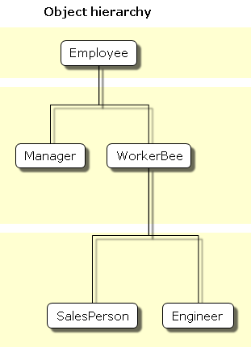
Objects - Classical Inheritance
Notes:
[1]

Slide 104
Objects - Classical Inheritance
Employee JAVA
Employee JavaScript
public class Employee {
public String name = ‘’;
public String dept = ‘’;
public Employee(){
this.name = ‘’;
this.dept = ‘’;
}
}
function Employee(){
this.name = ‘’;
this.dept = ‘’;
}
Notes:
[1]

Slide 105
Objects - Classical Inheritance
Manager JAVA
Manager JavaScript
public class Manager extends Employee {
public Employee[] reports;
public Manager() {
this.reports = new Employee[0]
}
}
function Manager(){
this.reports = [];
}
Manager.prototype = new Employee;
Manager.prototype.constructor = Manager;
Notes:
[2]

Slide 106
Multiple Inheritance
Multiple Constructor inheritance isn’t possible (BUT)
function Mother(){ this.worksHard = true;}
function Father(){ this.likesSport = true;}
function Son(){
this.isNaughty = true;
Mother.apply(this);
Father.apply(this);
};
s = new Son();
console.log(s);
Notes:
[5]
function Mother(){ this.worksHard = true;}
function Father(){ this.likesSport = true;}
function Son(){
this.isNaughty = true;
Mother.apply(this);
Father.apply(this);
};
s = new Son();
console.log(s);
Reiterate how does ‘this’ work.

Slide 107
Objects - prototypal inheritance
objects can be made from existing objects
objects can then be customized
You don’t really need Class
Notes:
[2]

Slide 108
Objects - prototypal inheritance
no operator to directly inherit from object
but Constructor.prototype - which can be used to assign parent
function object(o) {
function F() {}
F.prototype = o;
return new F();
}
Object.create(object);
Notes:
[2]
http://www.codeproject.com/Articles/687093/Understanding-JavaScript-Object-Creation-Patterns

Slide 109
prototype, __proto__, Constructor.prototype
Constructor has prototype member
it points to Constructor’s [prototype] object
this object also has a constructor member pointing to the Constructor
any instance of Constructor has __proto__ pointing to Constructor’s [prototype] object
__proto__ chain leads to Object.prototype
Notes:
[20]
function Car(){
this.name = 'automobile'
}
c = new Car();
c.__proto__ == Car.prototype
c.__proto__.__proto__ == Object.prototype
c.constructor == Car
c.constructor.constructor == Function
Draw a diagram to show … (present in the next slide)

Slide 110
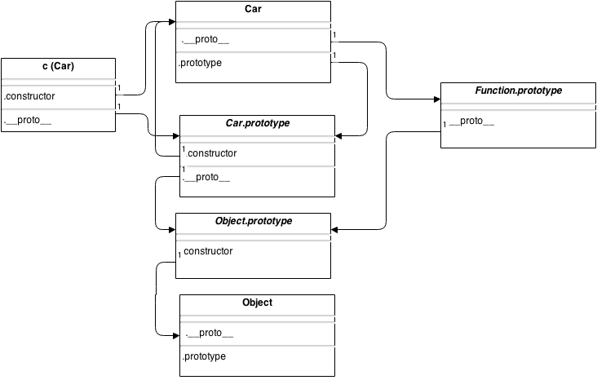
__proto__ की सौतन prototype

Slide 111
JSON - Javascript Object Notation
Used for serializing objects
Much lighter than XML
Initially was supported as external Lib
But from IE-8, Ff-31 and Chrome-31 is built in
JSON.parse()
JSON.stringify()
Notes:
[5]
Created by Douglous Crockford in April 2001
It was originally developed from Javascript’s object structure - but now its used across languages -
Support in Browsers was fairly late 2013 - 2014 with window.JSON module
o = {name: "Cersei", hair: "Blonde"}
oString = JSON.stringify(o);
console.log(JSON.parse(oString))

Slide 112
there is more...
But, I’ll leave it for reading.
Notes:
[1]

Slide 113
done with JavaScript
done with JavaScript …
Notes:
~ 1 hour 20 mins

Slide 114
यह सब तो ठीक है, पर असली माल तो बताओ

Slide 115
some tools…
JS Libraries (jQuery, dojo)
HTML/CSS Frameworks (bootstrap, zurb)
less
jshint
node.js
YUI Compressor
Notes:
[3]

Slide 116
JavaScript libraries
DOM Traversal
DOM Manipulation
Event handling
Animation
Ajax
Basic UI elements (with some libs)
Notes:
[10]

Slide 117
HTML/CSS Frameworks
Super quick conversions of wireframes to HTML
Professionally created beautiful, lovely, crisp curvy elements and widgets
Support the new ‘responsive’ website paradigm
Support a lot of customization with Less and Sass
Mostly integrated with some popular JS libraries
Notes:
[3]
bootstrap with jQuery, zurb is lightweight fork of jQuery
Explain what is responsive
https://gweb-worldcup-2014-trends.appspot.com/en-us/match/61/
http://www.android.com/versions/kit-kat-4-4/
http://www.harveywatersofteners.co.uk/history-interior-design
http://getbootstrap.com
http://jquery.com
https://gist.github.com/ruturajv/baa710a8d4c5a6a63aa1 (todo-with-bootstrap-jquery)

Slide 118
less
CSS pre-processor
@variables @nice-blue: #5B83AD; @light-blue: @nice-blue + #111; #header { color: @light-blue; }
Notes:
[3]
http://lesscss.org

Slide 119
less
Mixins
Can include bunch of props inside other selectors
.bordered { border-top: dotted 1px black; border-bottom: solid 2px black; }
#menu a { color: #111; .bordered; } .post a { color: red; .bordered; }
Notes:
[2]

Slide 120
jshint
Younger cousin of http://jslint.com
tool to detect errors, possible problems
Helps to maintain standards in coding
Available in various tools
Notes:
[5]
show some sublime text tool with jshint, copy the code for todo and try doing a jshint
http://jshint.com
http://jslint.com
https://github.com/victorporof/Sublime-JSHint

Slide 121
node.js
a JS platform built on Google’s V8 JS engine
Event driven
Non IO-Blocking model
Usages
HTTP Server (built-in, socket.io)
Proxy (built-in)
Build tool (gruntjs, phonegap)
Testing (mocha, gruntjs)
Dependency mgmt. (bower)
CLI (commander.js)
Notes:
[5]
could be used with grunt.js as a testing tool.
http://nodejs.org/

Slide 122
YUI - Compressor
Compresses JavaScript, CSS
Renames local variables to smaller identifiers to conserve space/bandwidth
Can remove redundant “;”
Built on Mozilla Rhino (OpenSource JavaScript runtime in JAVA)
Notes:
[5]
var MOD1 = (function() {
var name = "Ruturaj",
lastName = "Vartak",
department = "media.net";
function getName() {
return name + " " + lastName;
}
return {
dept: department,
getFullName: getName
}
})();
MOD1.getFullName();
java -jar /home/rutu/code/rtb-ui/rtb/js/yuicompressor-2.4.6.jar j.js
http://www.adequatelygood.com/JavaScript-Module-Pattern-In-Depth.html
http://addyosmani.com/resources/essentialjsdesignpatterns/book/
http://yui.github.io/yuicompressor/

Slide 123
Thanks!
गले की लग गई
Notes:
~1:30 mins

Slide 124
Task: in-place Edit
http://localhost/ruturaj/inplace-edit-bootstrap.html
Template - http://localhost/ruturaj/inplace-edit-bootstrap-template.html
https://gist.github.com/ruturajv/e9f4d8b1da06e366e296
Notes:
http://localhost/ruturaj/inplace-edit-bootstrap.html

Slide 125
Task: jQuery Plugin
“mark” a given text
// so idea is to create a plugin
$(selector).mark(textMark [,options]);
options = {
backgroundColor: ”hex”,
color: ”hex”,
fontWeight: [normal|bold]
}
Notes:
https://learn.jquery.com/plugins/basic-plugin-creation/
// Show demo by editing an actual page and manually inserting a mark element - That should be done by the plugin.

Slide 126
References
Almost everything is gold dust (http://javascript.crockford.com/)
http://javascript.crockford.com/private.html
http://javascript.crockford.com/prototypal.html
Object Model
JS Object Creation Patterns
Prototypal Inheritance
MDN
Browser Compatibility
http://kangax.github.io/compat-table/es5/
http://caniuse.com/
HTML / DOM - Gold Dust yet again - http://quirksmode.org/
CR
https://c.internal.directi.com/display/pSwTrain/JavaScript
Videos, many slides directly inspired from here
Chrome Dev tools
http://www.html5rocks.com/en/
https://developer.mozilla.org/en-US/docs/Web/Guide
https://developer.mozilla.org/en-US/docs/Web/Tutorials

